Slide 1
Outline
Structure of MimtPy
Functions of viewer_PS_tiff.py
Deformation field of Beijing

Slide 2
MimtPy
1. Concatenation function
Concatenate S1*.he5 file generated by MintPy: chunks=>track; tracks=>deformation field
concatenate_offset.py
concatenate_chunks.py
concatenate_tracks.py
Concatenate S1*.he5 file generated by MiaplPy: patches => deformation field
concatenate_radarGeo.py
concatenate_patches.py

Slide 3
MimtPy
2. Geotectonic modeling script
2.1 RELAX
generate_script_RELAX.py: generate multiple input files of RELAX
gridsearch_ramps_relax.py and gridsearch_ramps_batch_relax.py: invert the viscosities using whole image
grid_search_RELAX.py: invert the viscosities using quadtree downsampling points
2.2 pscmp/psgrn
pscmp_dat2h5.py: generate NS/EW/UP directions and latlon *.h5 files based on pscmp *.dat files
Generate NS/EW/UP directions *.tiff and *.json files based on psgrn/pscmp *.dat files

Slide 4
MimtPy
2. Geotectonic modeling script
2.3 GBIS
save_gbis_mimt.py: Prepare MintPy data for GBIS software
2.4 Geodmod
save_geodmod.py: Prepare MintPy data for Geodmod software
2.5 InsarMap
save_insarmap: Prepare MintPy data for insamp software based on ROIPAC format
2.6 Pyrocko
save_kite.py: Prepare MintPy data for Pyrocko Kite software

Slide 5
MimtPy
3. Small tools
multi_transects.py: calculate and plot the profiles perpendicular to faults
overlap2horz_vert.py: Calculate horizontal and vertical component for overlapping region
resampleGrd2Mintpy.py: resample Relax grd file into Mintpy h5 file using nearest method
resampleH52Mintpy.py : resample Relax h5 file into Mintpy h5 shape
resampleMintpy2LOS.py: calculate LOS deformation based on RELAX results
synthetic_S1.py: simulate tectonic/atmospheric ramps for MintPy h5 data
plot_geojson.py: do plot based on geopandas data frame

Slide 6
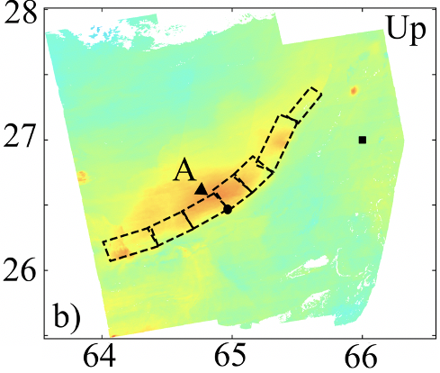
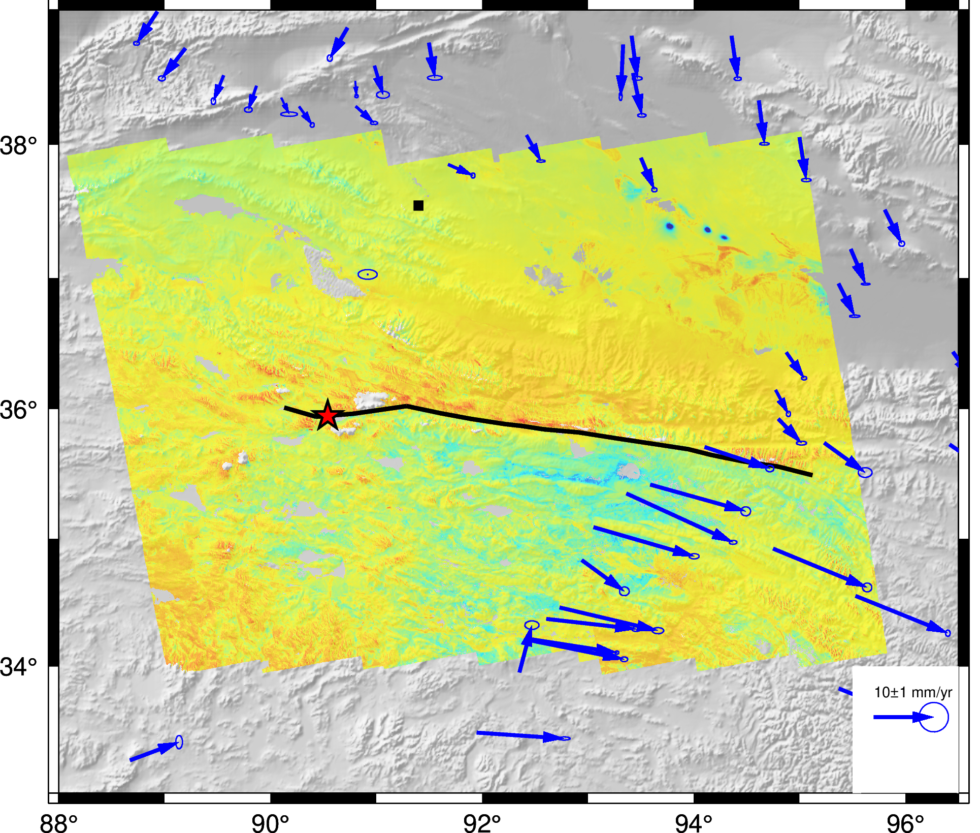
MimtPy
4. Plot function
4.1 plot deformation results generated by MintPy [geopandas and rasterio]
HDFEOS_to_geotif.py/H5UNW_to_geotiff.py + plot_geotiff.py
deformation field with multiple faults
deformation field with multiple faults and one GPS velocity vector
deformation field with multiple faults and multiple GPS velocity vectors
only plot GPS velocity vectors

Slide 7
MimtPy
4. Plot function
4.2 plot deformation results generated by MiaplPy: viewer_PS_tiff.py [geopandas, shapely, pyproj, rasterio]
display velocity field on optical image with subset args
display velocity field on optical image with polygon
display velocity field and show the time series of chosen point selected by mouse (interactive mode)
--save_txt: save the time series to txt file
extract and display velocity field based on polyline and buffer distance
--save-gdf: save the extracting PS points into geopandas data frame
analyze the PS points density in the buffer

Slide 8
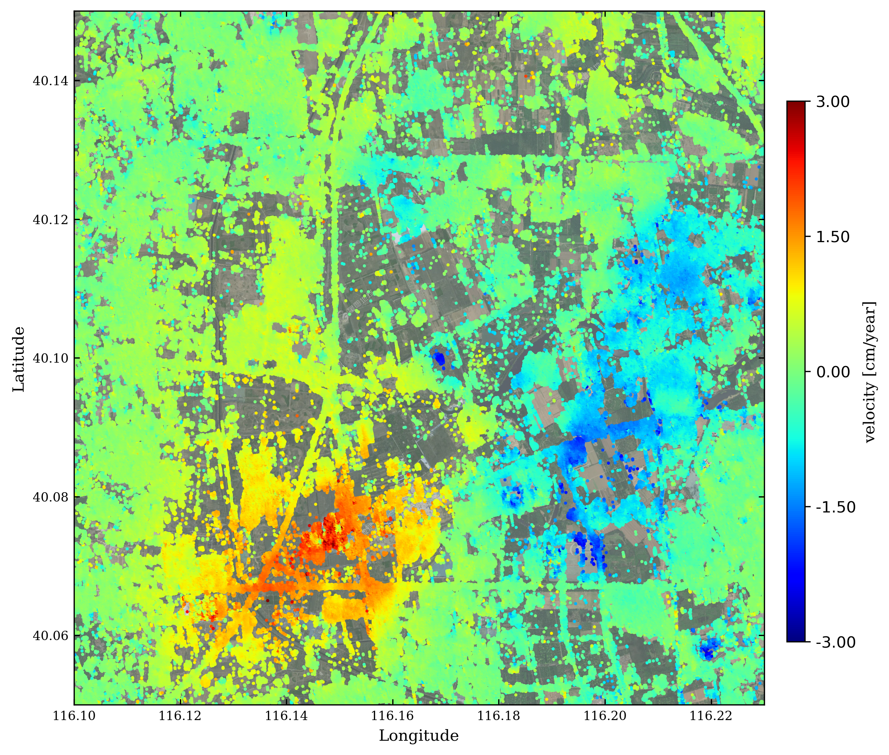
viewer_PS_tiff.py
display velocity field on optical image with subset args
viewer_PS_tiff.py velocity.h5 --tiff_file ../tiff/sanheshi.tif --geo_file ./inputs/geometryRadar.h5 --subset 39.8 40.09 116.75 117.30 --vlim -3 3 --output **.png --outdir ./

Slide 9
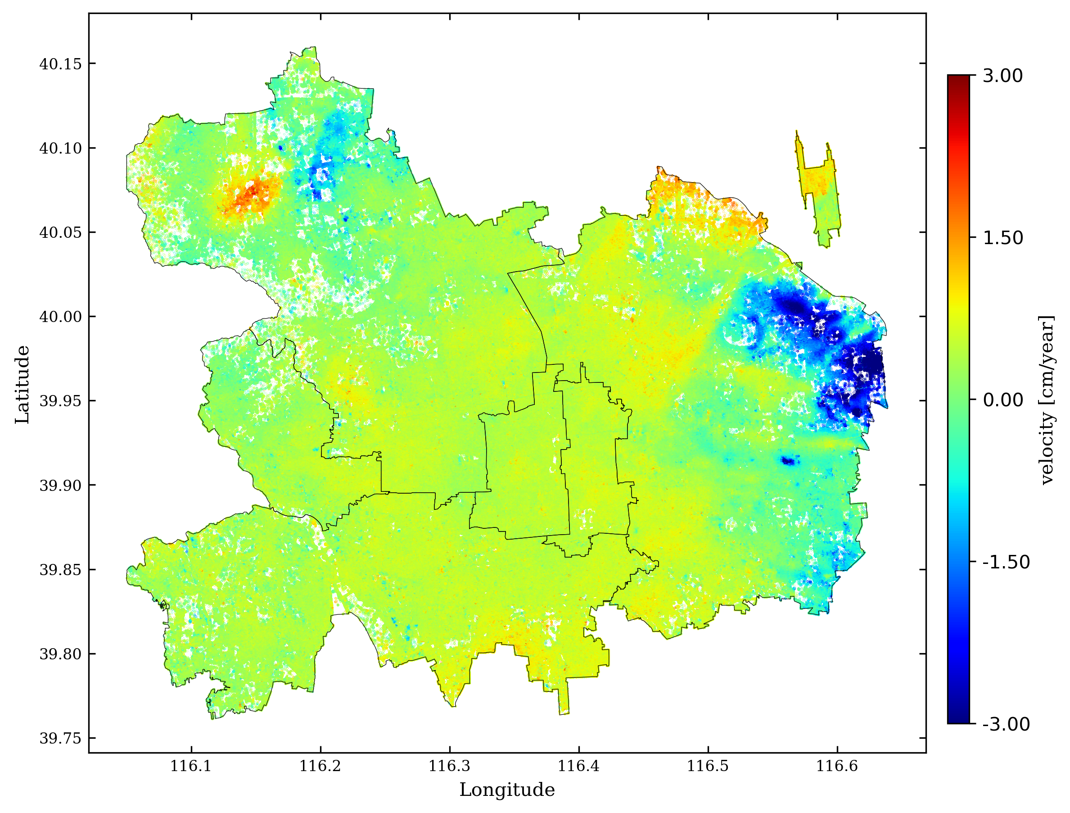
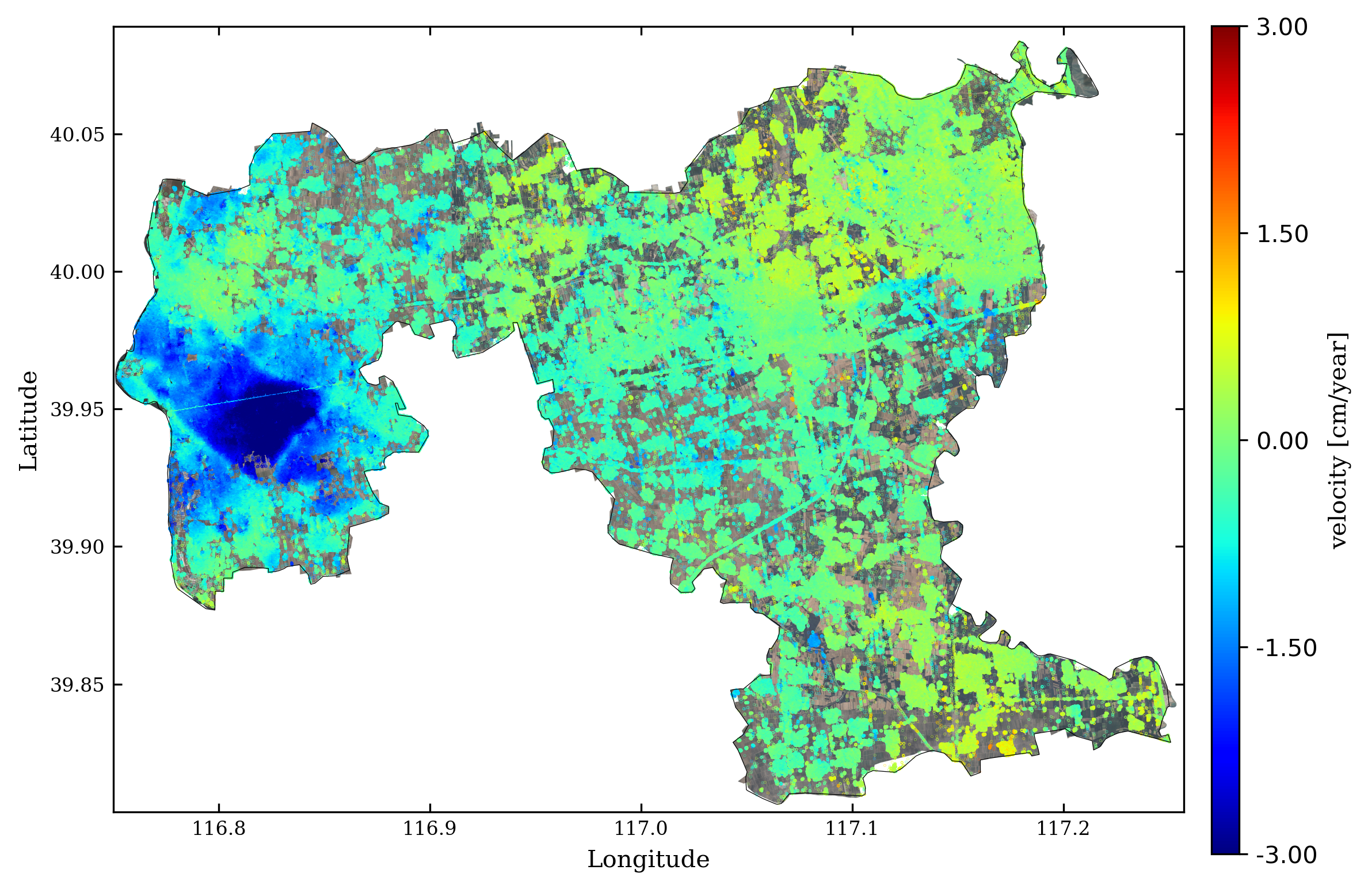
viewer_PS_tiff.py
display velocity field on an optical image with a polygon shapefile
viewer_PS_tiff.py velocity.h5 --shp_file ../shapefile/Beijing/SixDistricts.shp --geo_file ./inputs/geometryRadar.h5 --subset 39.76 40.16 116.05 116.64 --shp_type polygon --vlim -3 3 --output ***.png --outdir ./ --markersize 0.1

Slide 10
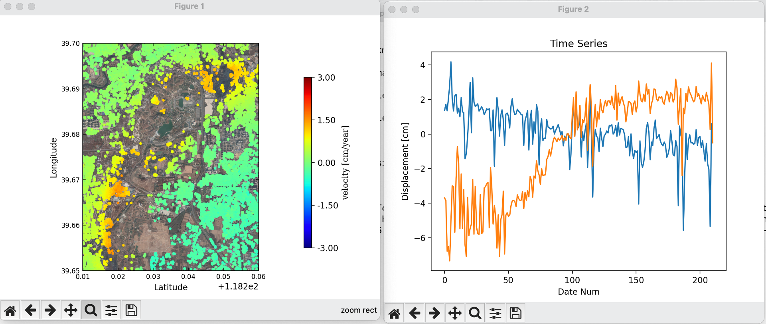
viewer_PS_tiff.py
display velocity field and show the time series of chosen point selected by mouse (interactive mode)
viewer_PS_tiff.py velocity.h5 --tiff_file tangshan_NE_patch.tiff --geo_file ./inputs/geometryRadar.h5 --subset 39.6 39.7 118.2 118.3 --vlim -0.4 0.4 --ts_file ./TangshanSenAT69/miaplpy_NE_201410_202212/network_single_reference/timeseries.h5 –interactive – save_txt

Slide 11
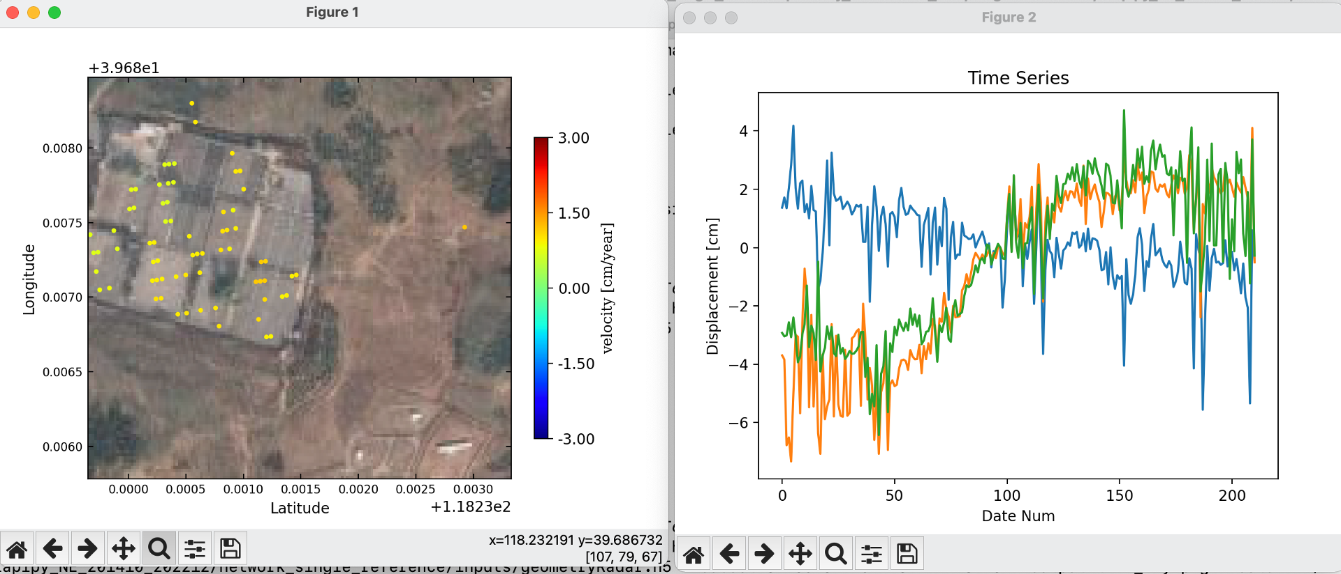
viewer_PS_tiff.py
display velocity field and show the time series of chosen point selected by mouse (interactive mode)
Shortage：users have to zoom in to selected the points.

Slide 12
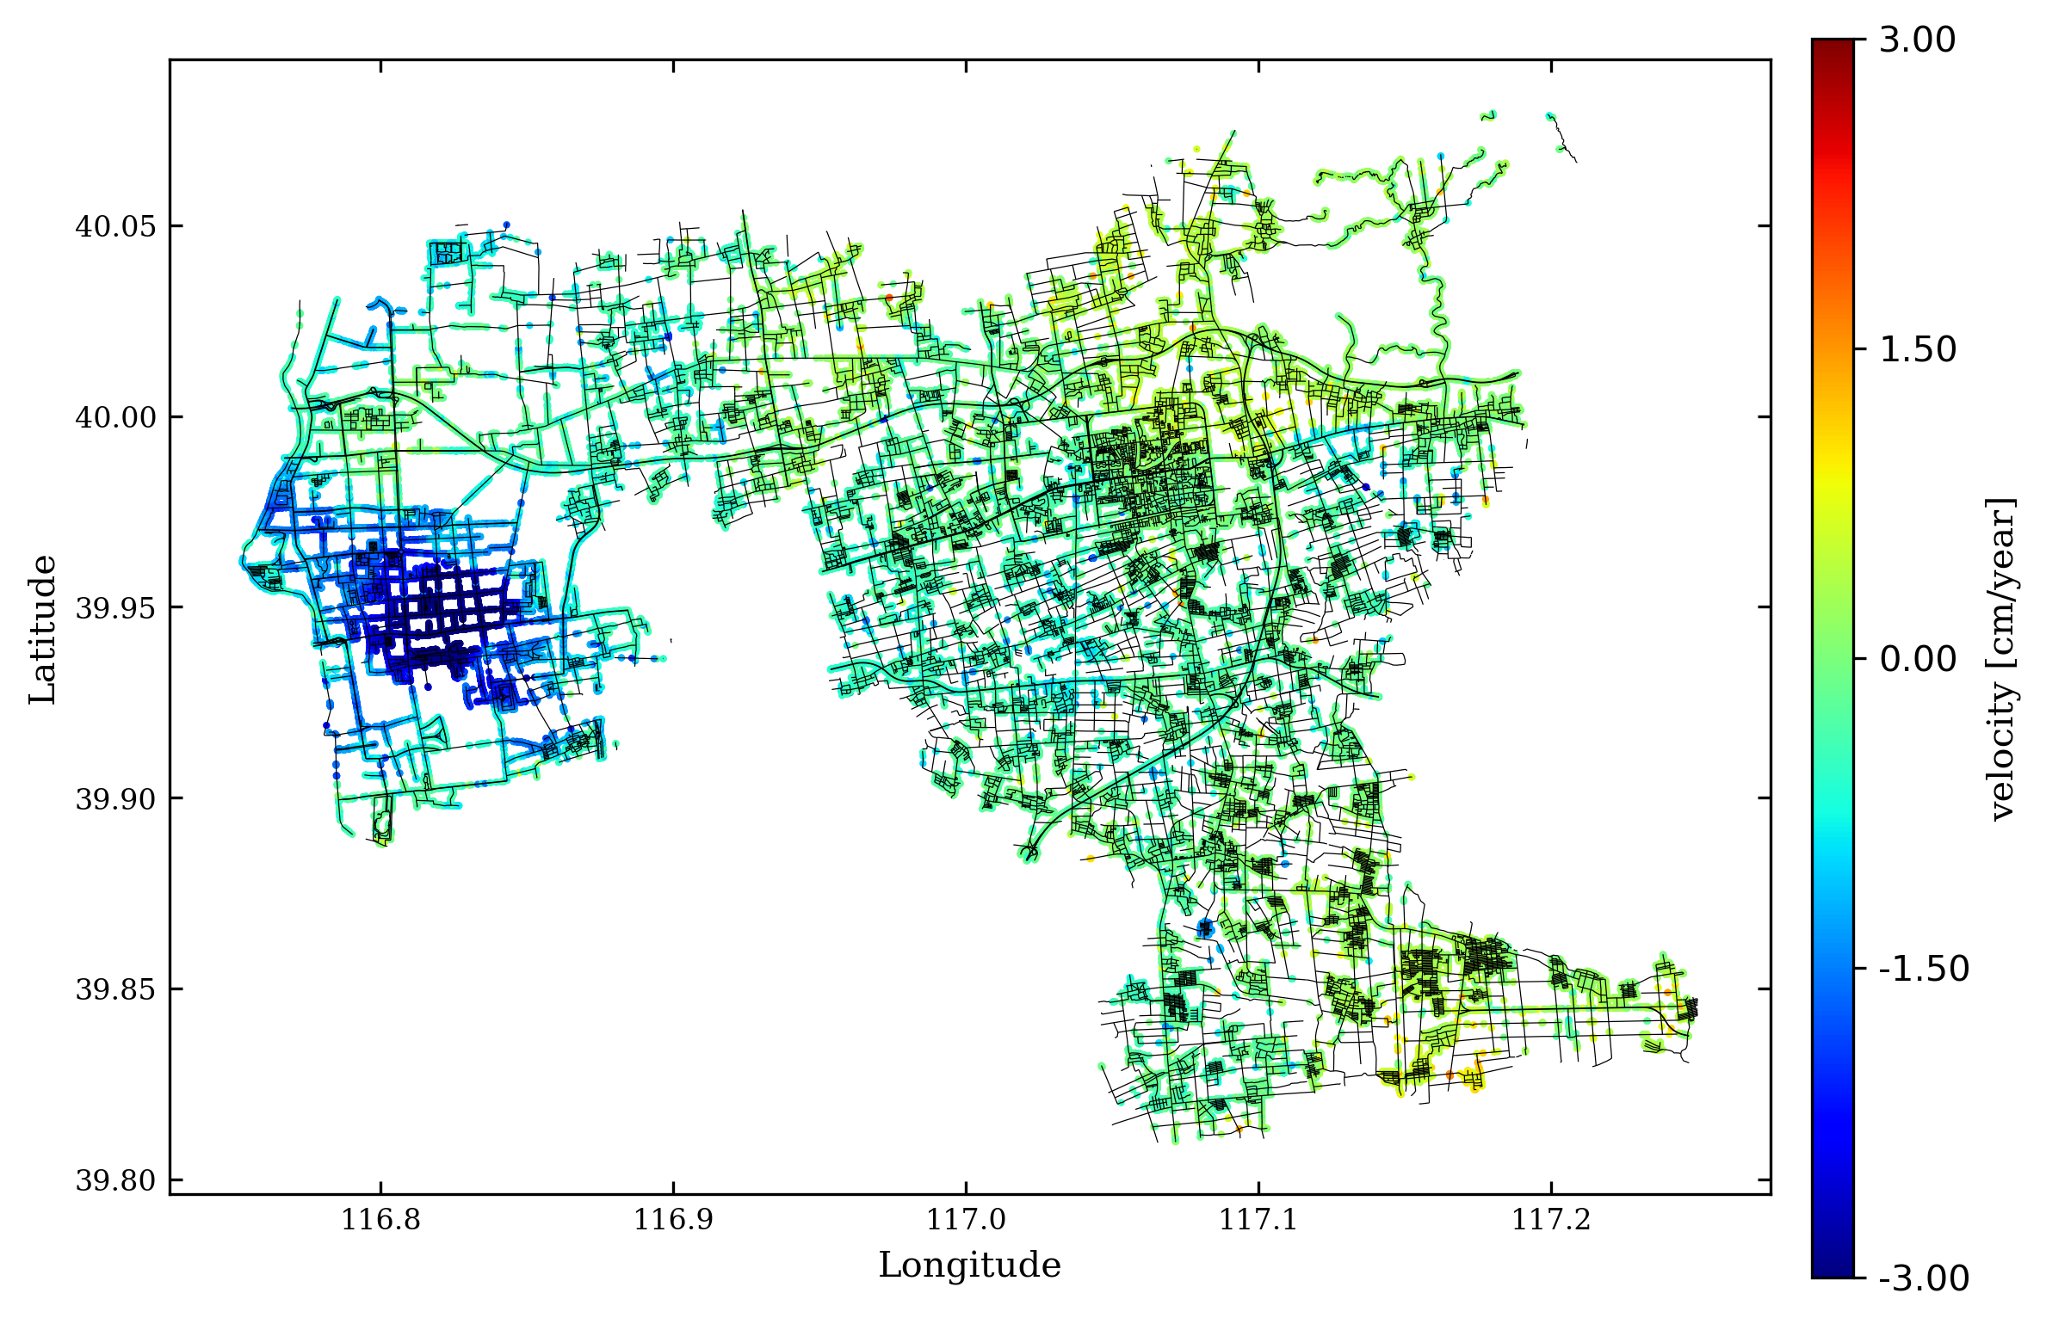
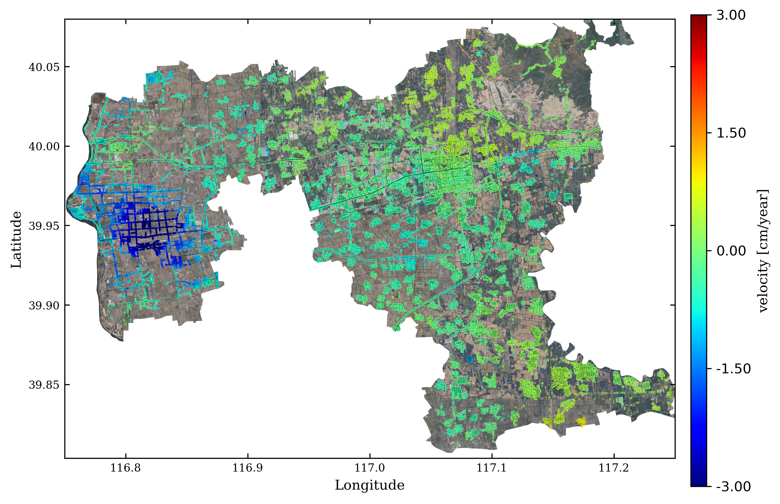
viewer_PS_tiff.py
extract and display velocity field based on polyline shapefile and buffer distance
viewer_PS_tiff.py velocity.h5 --shp_file ../shapefile/roads.shp --geo_file ./inputs/geometryRadar.h5 --subset 39.8 40.08 116.75 117.25 --vlim -3 3 --output ***.png --outdir ./ --shp_type line --save_gdf --buffer 5

Slide 13
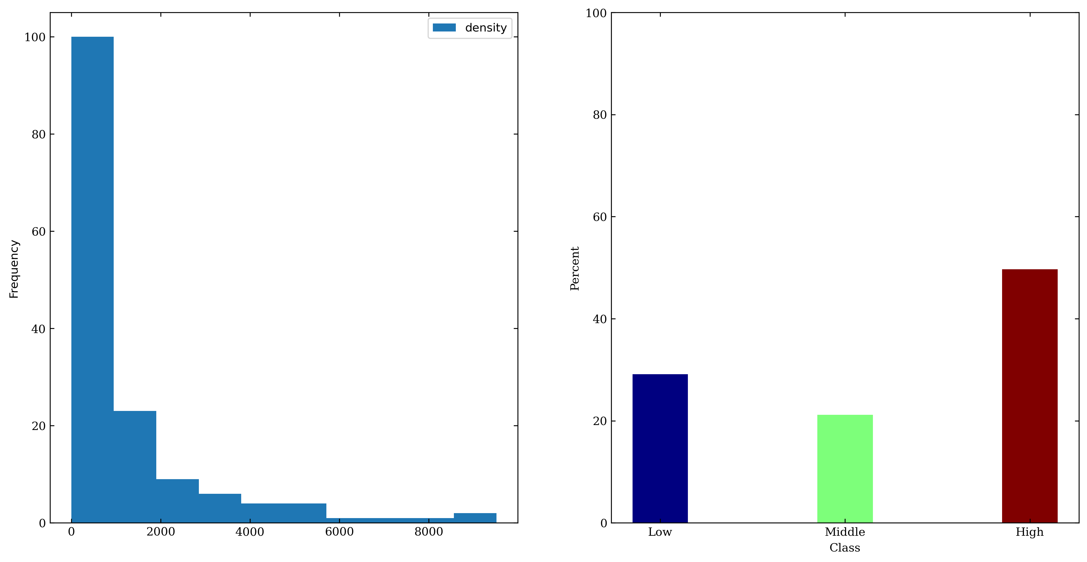
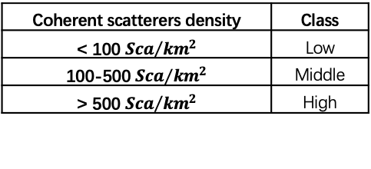
viewer_PS_tiff.py
analyze the coherent points density in the buffer
viewer_PS_tiff.py velocity.h5 --shp_file ../shp/Beijing_Transfer/railway_subway_OSM.shp --geo_file ./inputs/geometryRadar.h5 --subset 39.95 40.02 116.50 116.56 --vlim -3 3 --output PS_density.png --outdir ./ --shp_type line --buffer 10 --density --interval 500
Coherent scatterers density | Class
< 100 ${Sca}/{{km}^{2}}$ | Low
100-500 ${Sca}/{{km}^{2}}$ | Middle
> 500 ${Sca}/{{km}^{2}}$ | High
Density [Sca/km²]

Slide 14
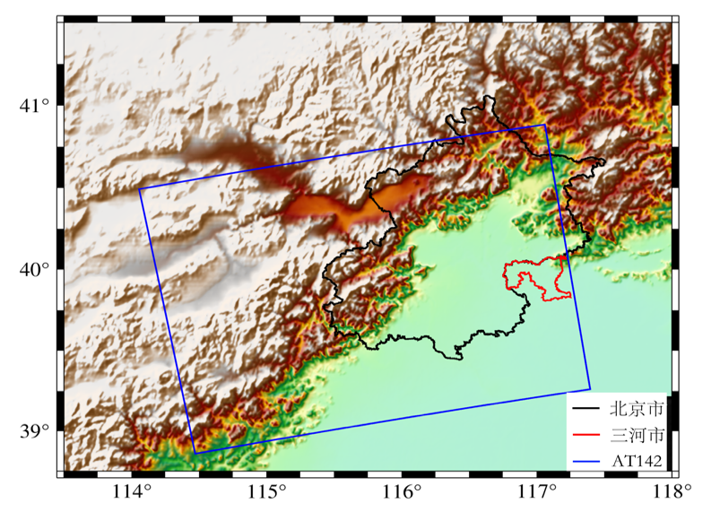
Deformation of Beijing
Sentinel-1 AT 142
202110-202310
Aim:
Whether the flood of 20220731 have influence
Whether the COVID-2019 have influence

Slide 15
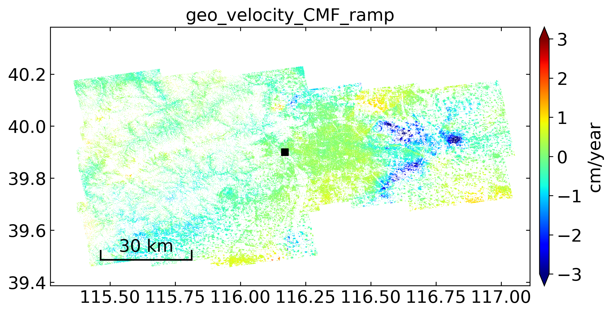
LOS displacement field of Beijing

Slide 16
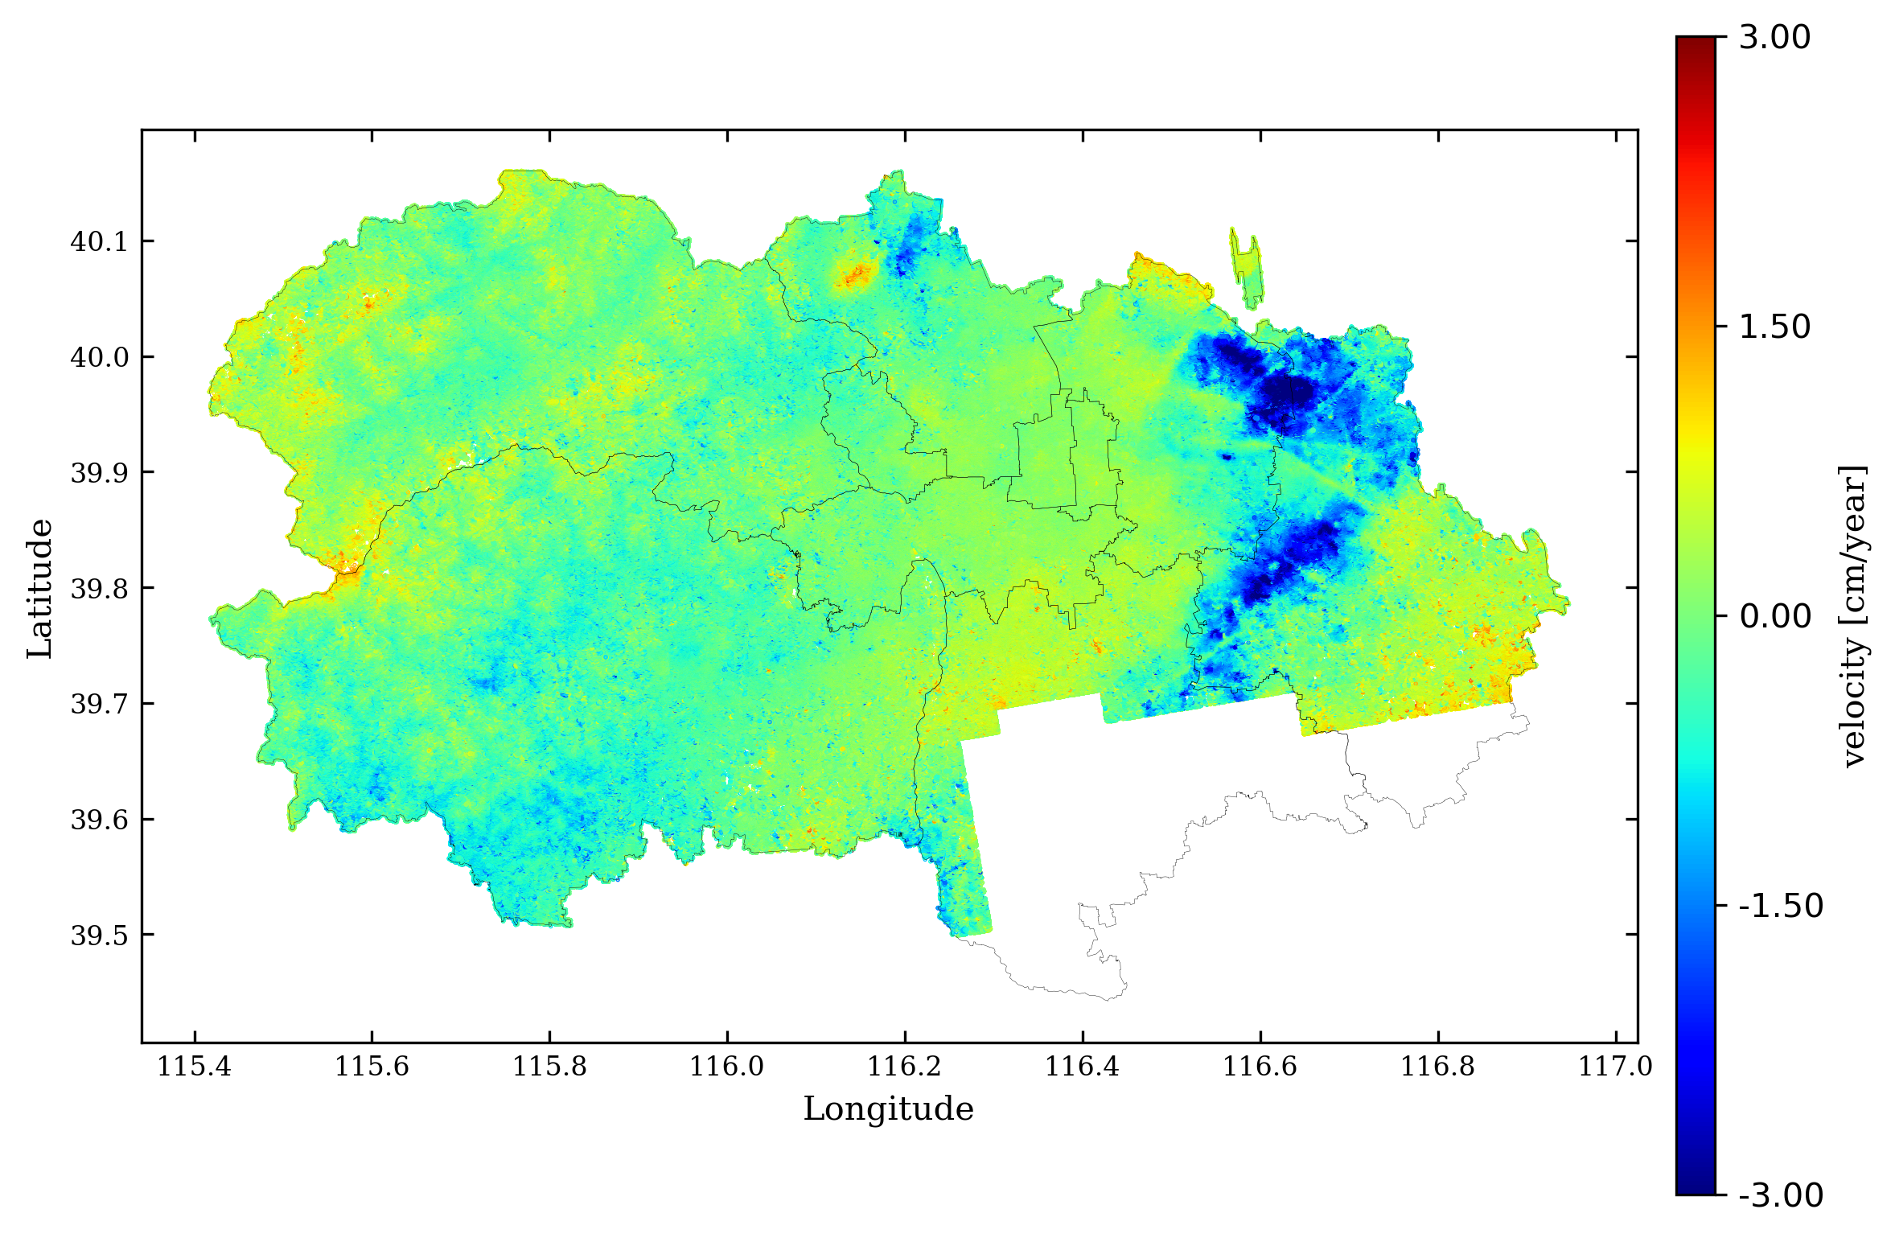
LOS displacement field of Central City
No faults pass through
could be induced by subway??

Slide 17
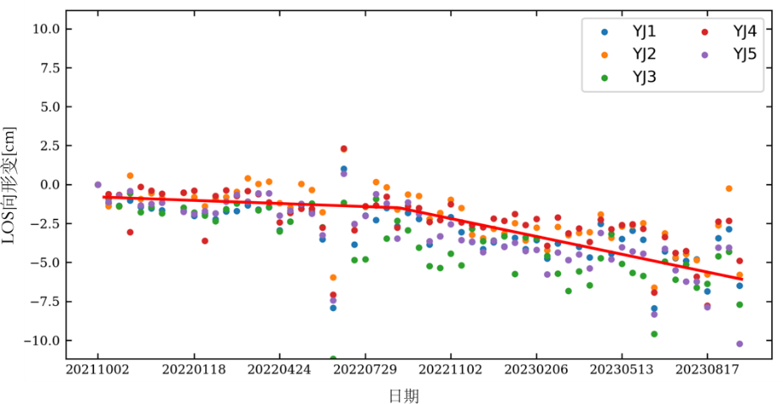
LOS displacement field of Central City
In the first half of 2022, the Yanjiao area suffered three large-scale lockdown for a long time due to the severity of the epidemic.
In the second half of 2022, with policy changes and the alleviation of the epidemic, there is basically no large-scale lockdown in Yanjiao.
Subsident bond from Chaoyang-Tongzhou-Daxing-Yanjiao

Slide 18
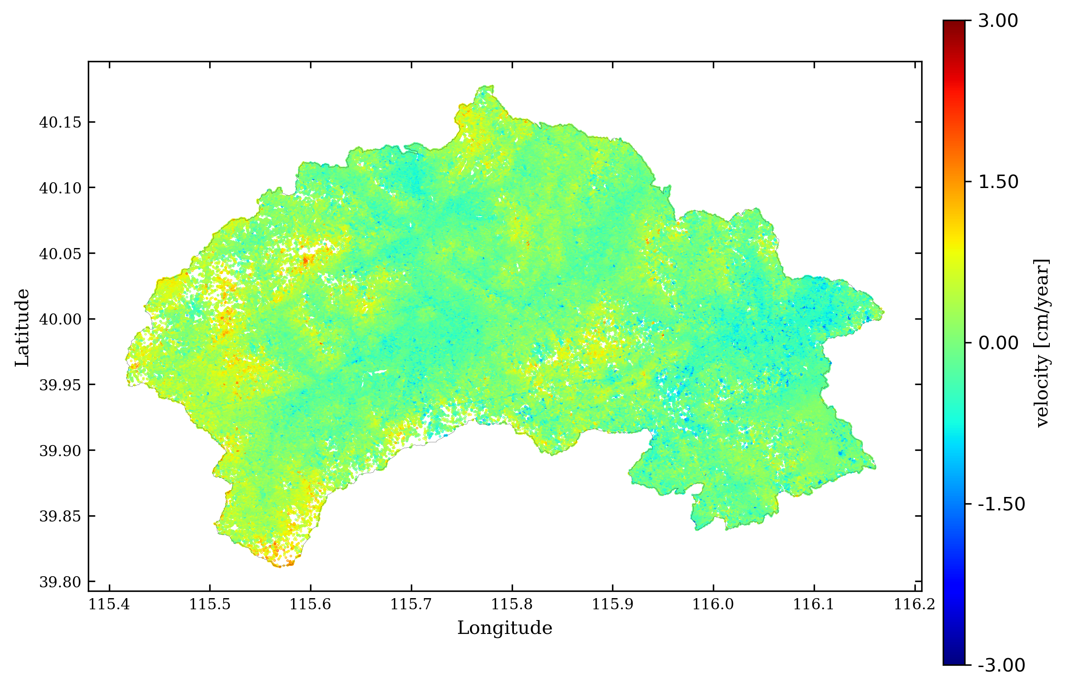
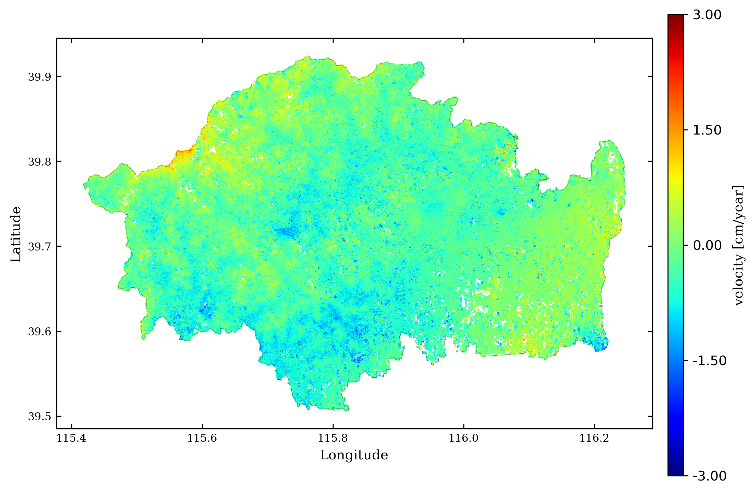
LOS displacement field of Mentougou and Fangshan District [possible landslide]
Seems no significant landslide region…

Slide 19
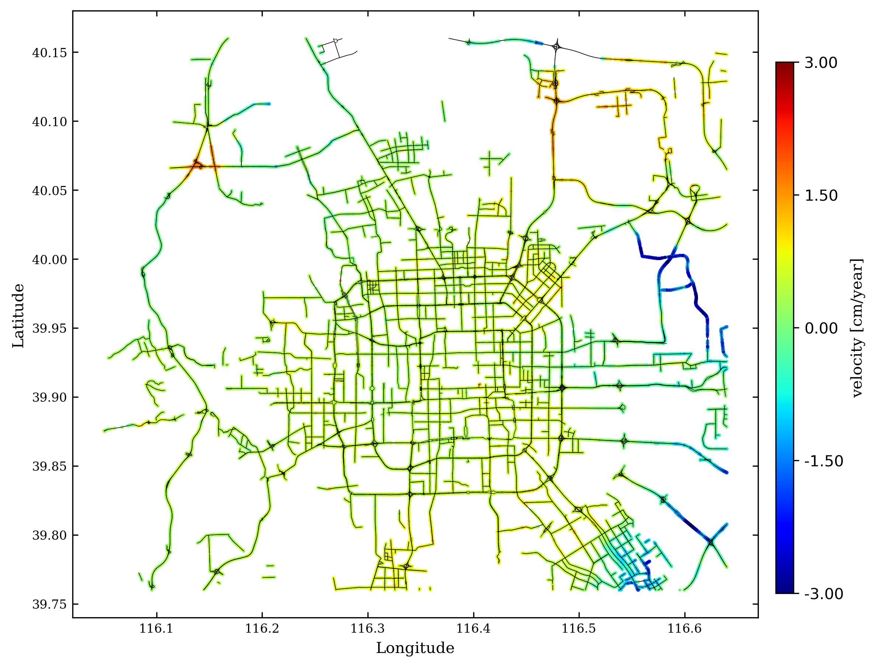
LOS displacement field of highway and level 1 road in Beijing

Slide 20
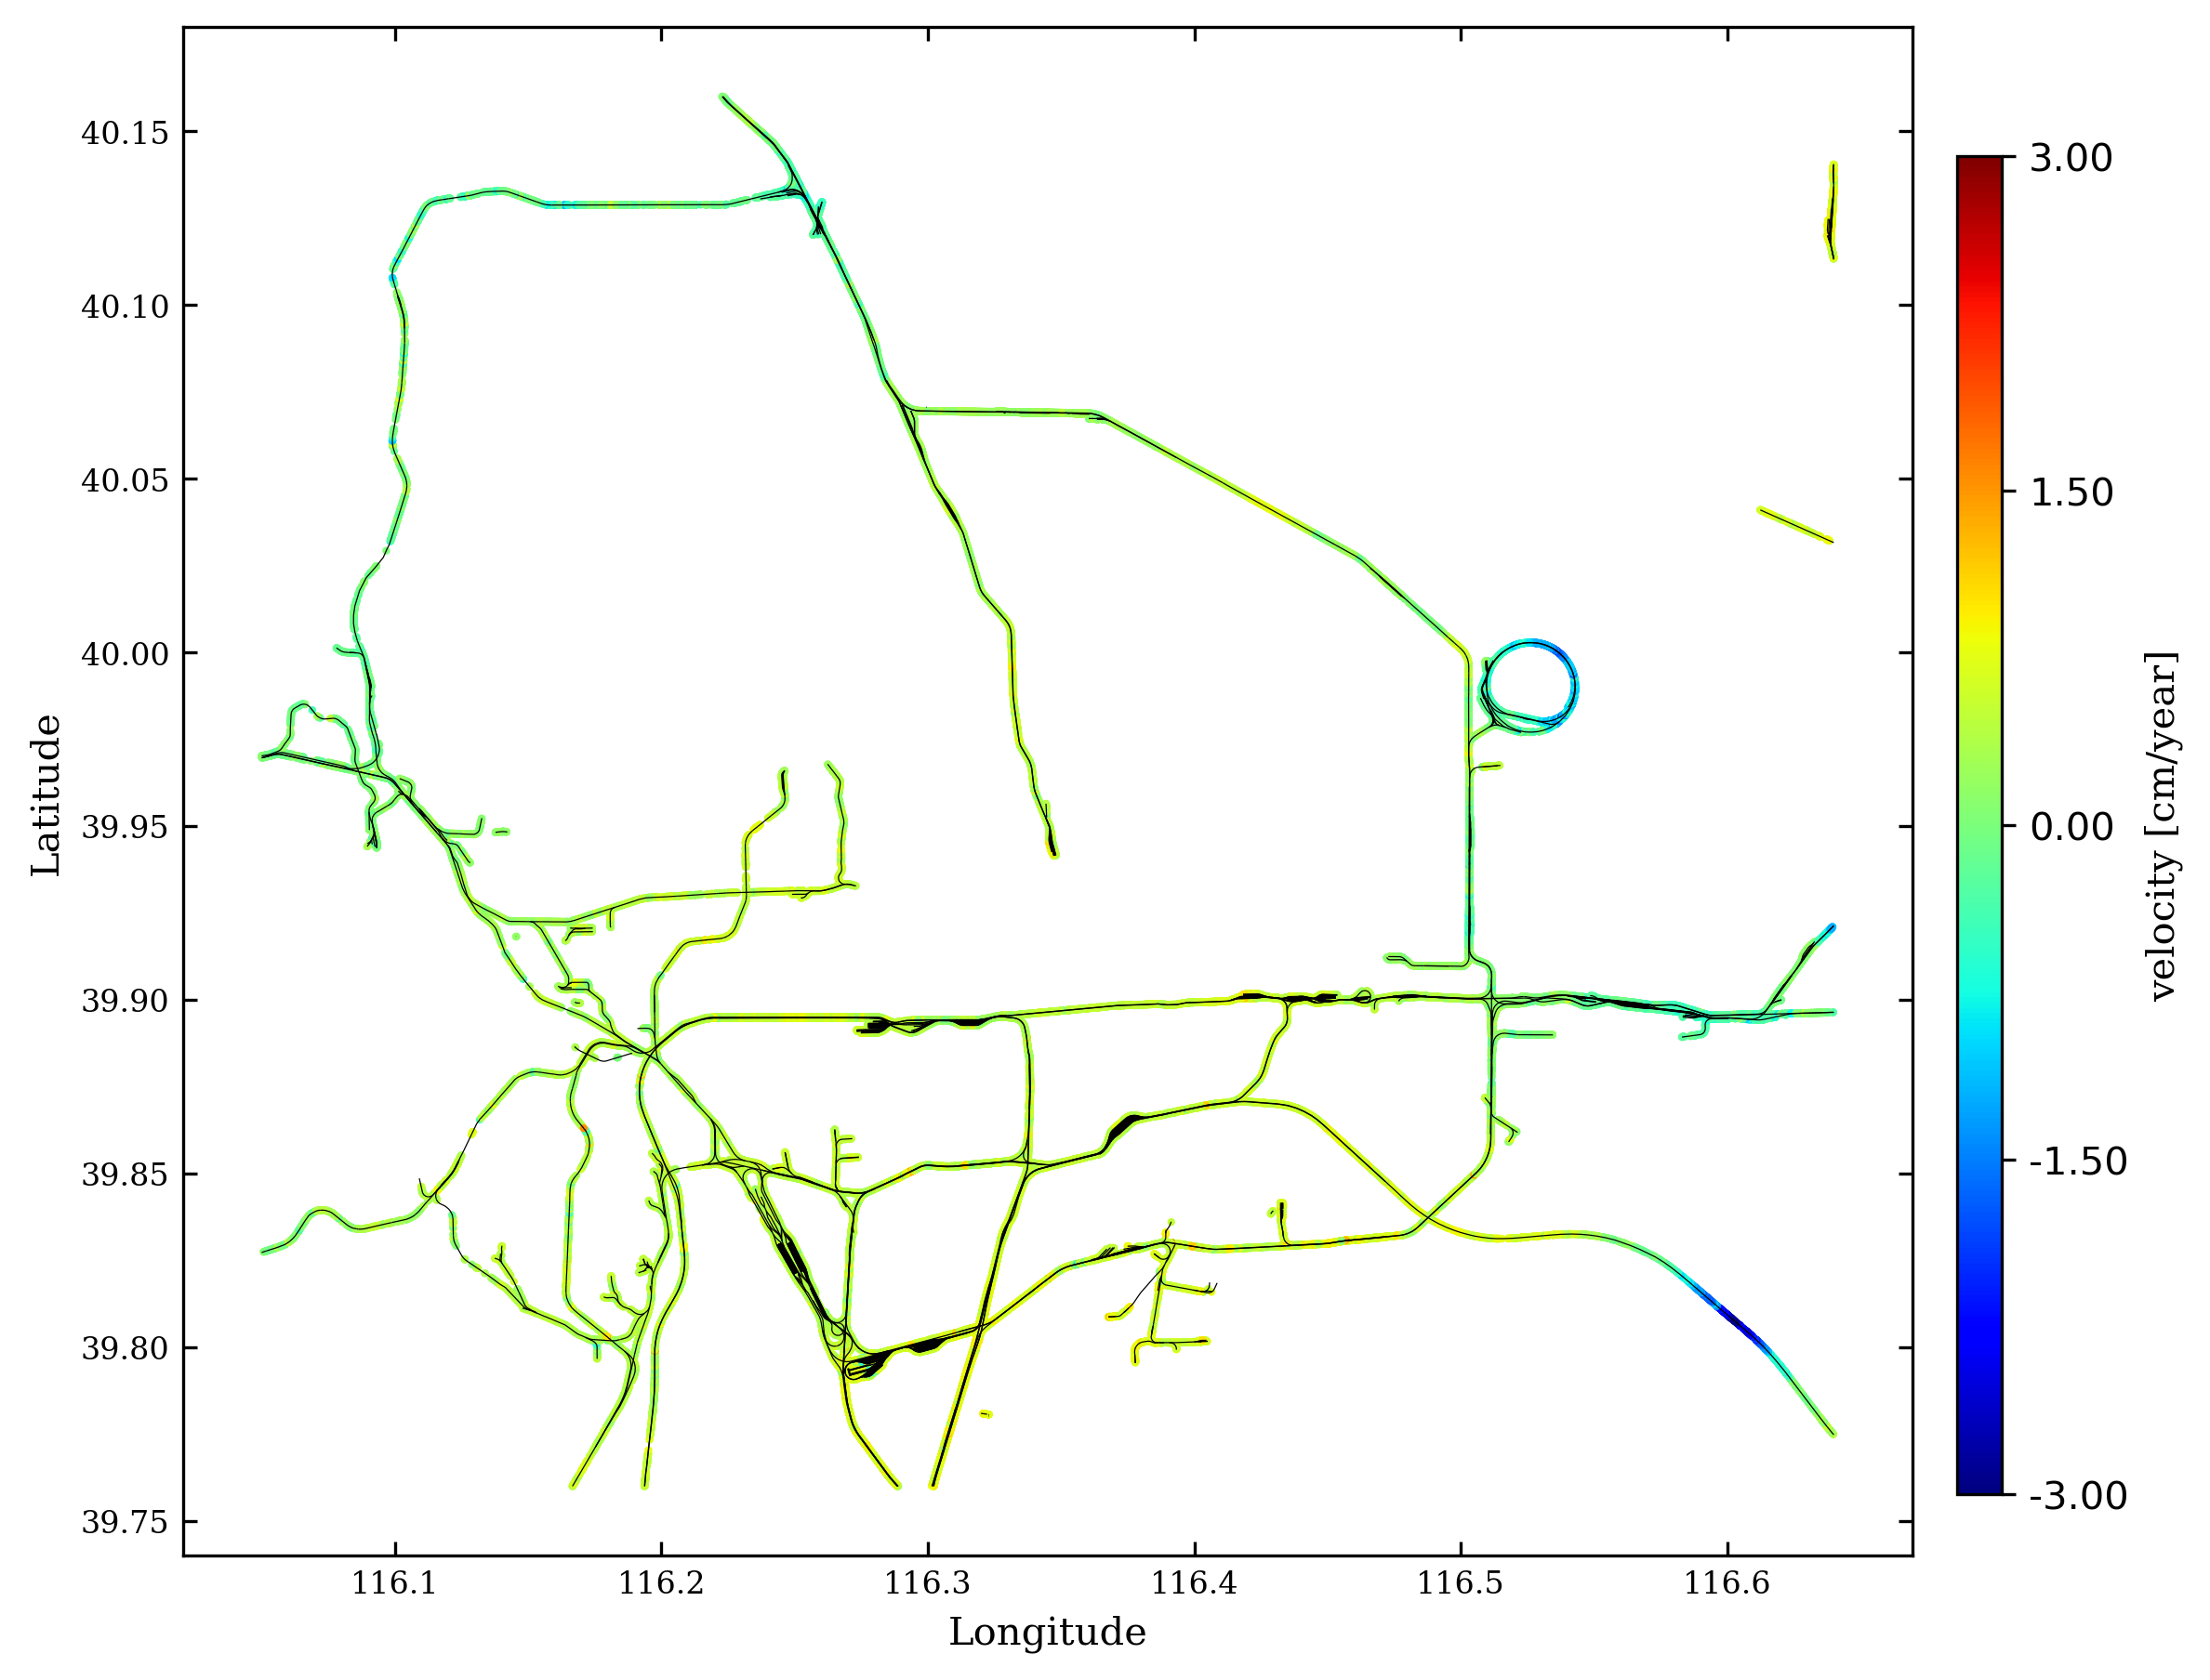
LOS displacement field of rail way in Beijing

Slide 21
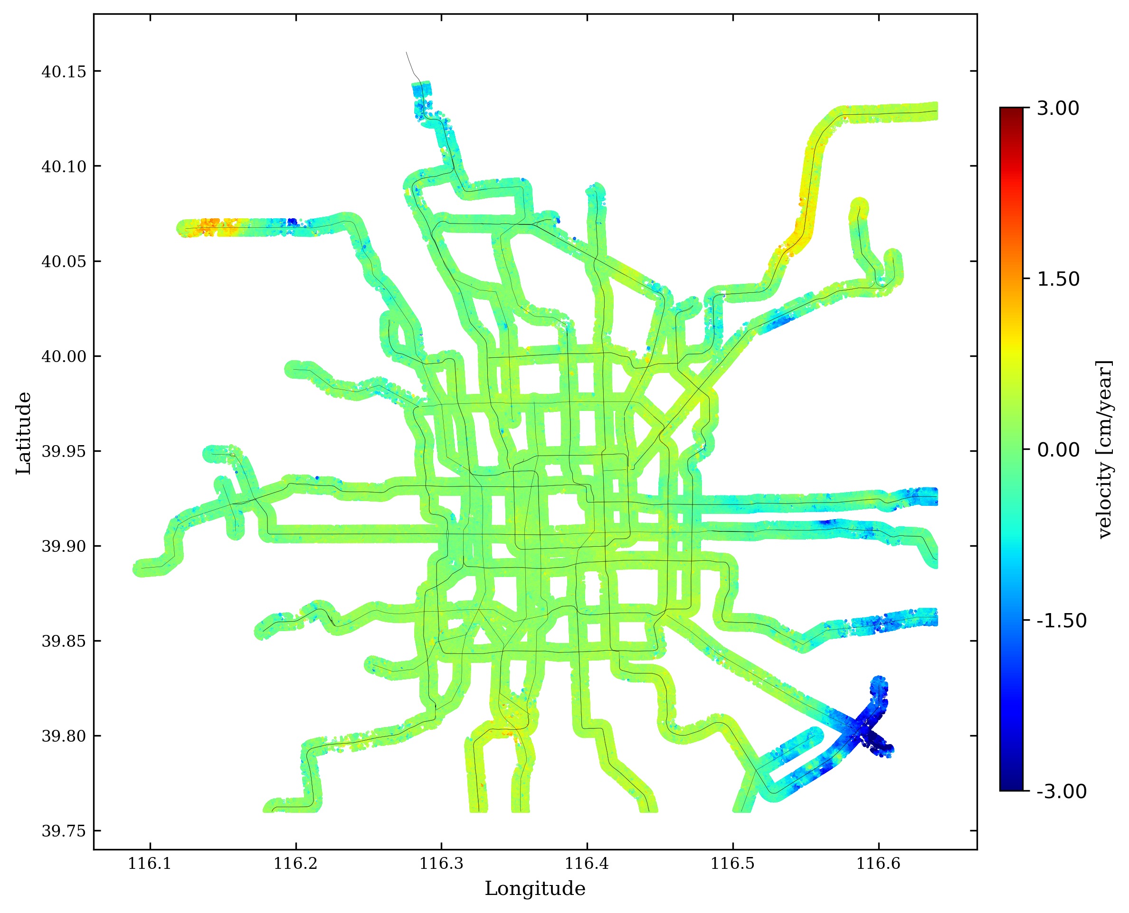
LOS displacement field of subway in Beijing

